Slide 1
Mountain Paths
CMPT 306
Heidi Andre

Slide 2
CMPT 306
Overview
Takes elevation data from GeoTiff a downloaded image.
Finds a path across the image using either Greedy (red) or A* (yellow) algorithm.
Displays path on greyscale visualization of elevation data.
Plots line across the image, color of line based on algorithm used.

Slide 3
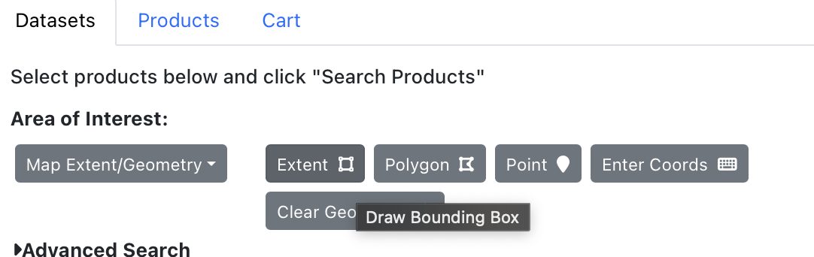
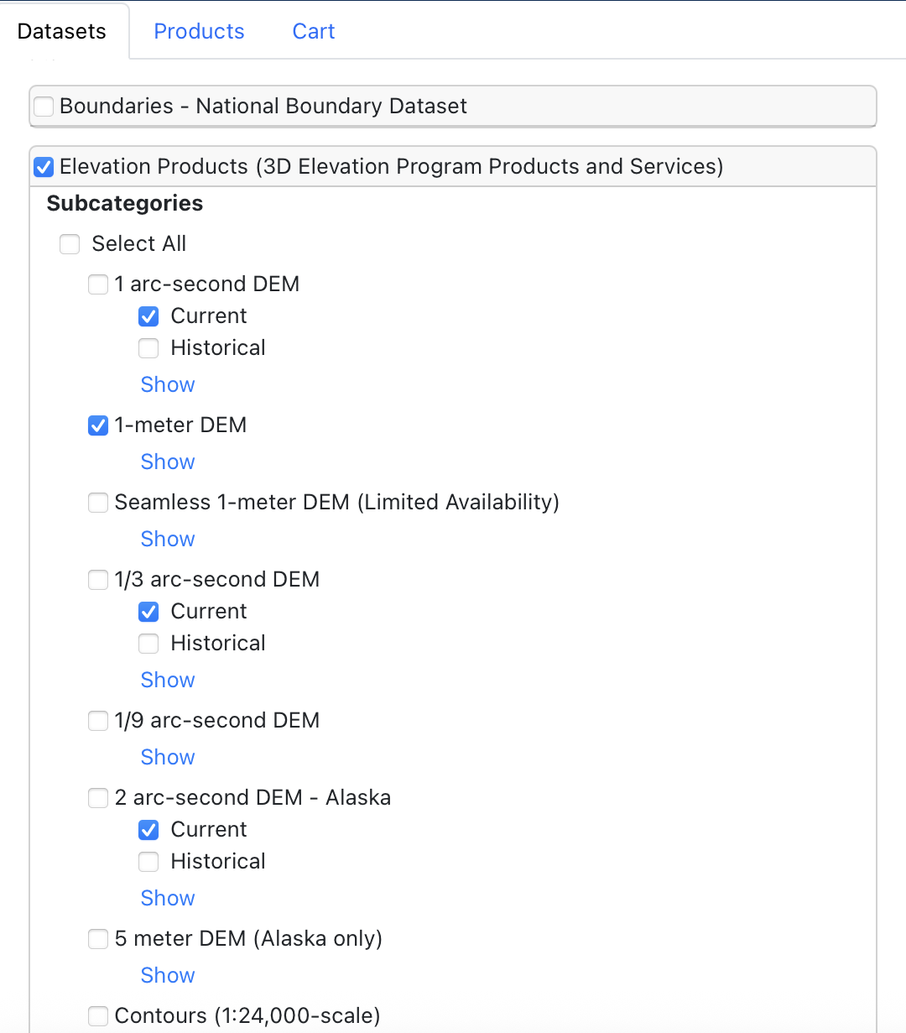
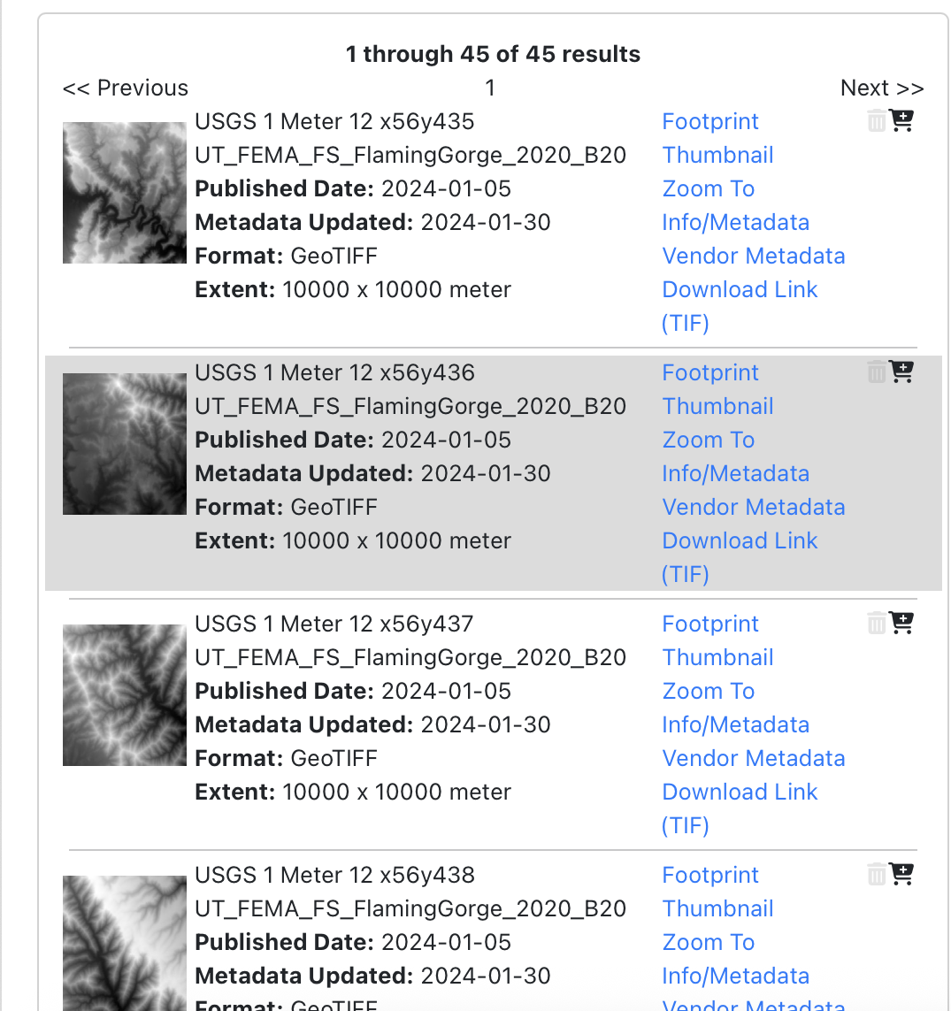
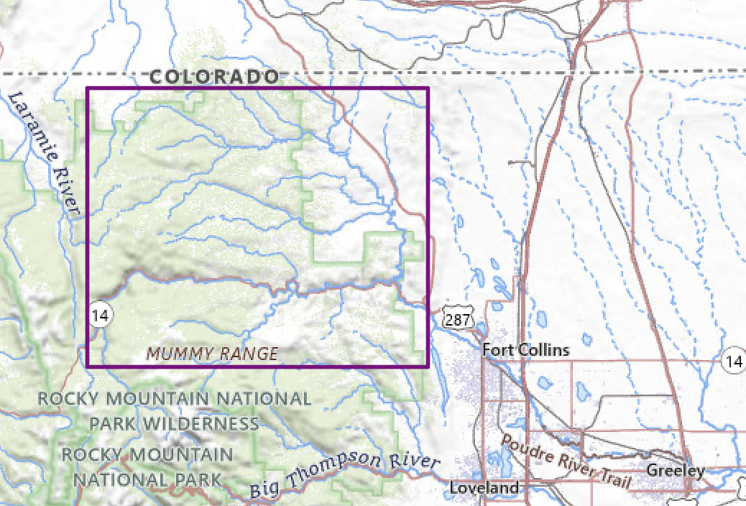
CMPT 306
GeoTiff Downloading Steps
USGS National Map
Step 1
Go to the USGS National Map Downloader. Use the “Extent” tool to select an area on the map.
Step 2
In the data section select “Elevation Products (3D Elevation Program Products and Services)”. For the purposes of this project I chose the 1-meter DEM option.
Step 3
Click the blue “Search Products” button and scroll until you see an image that fits the area you want to look at.

Slide 4
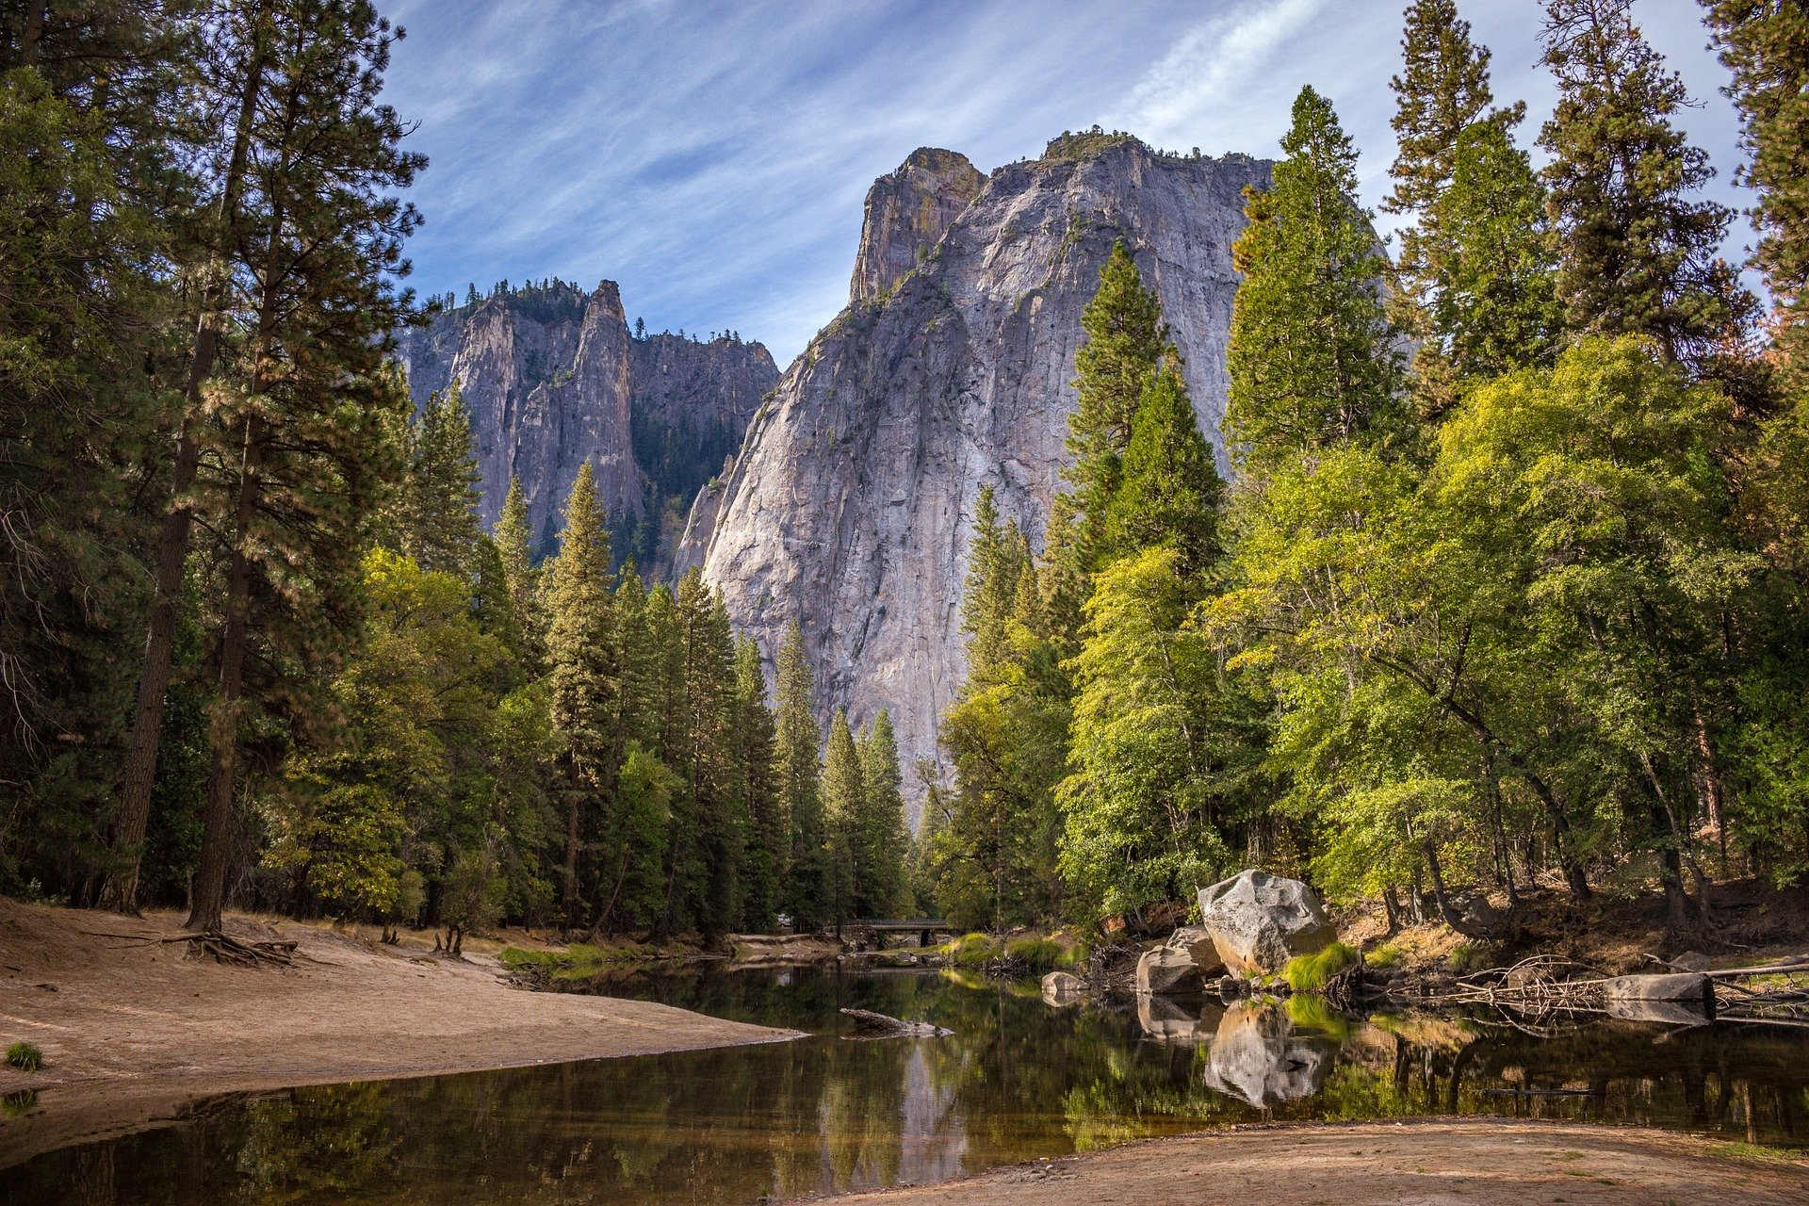
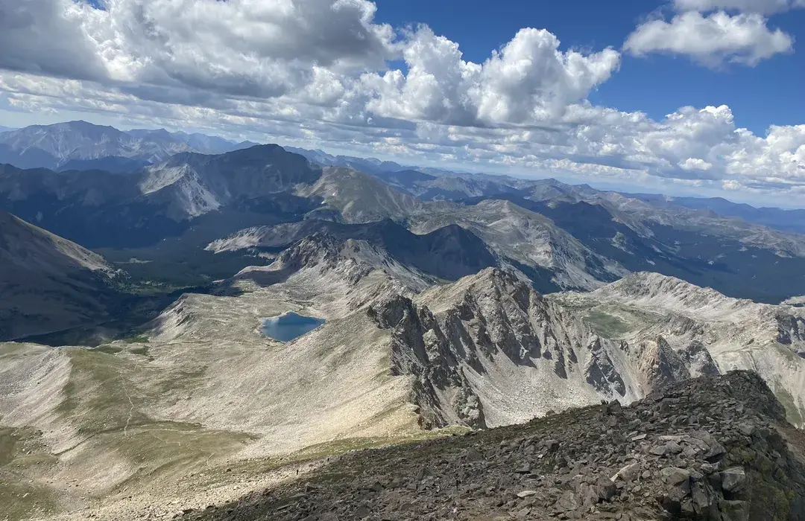
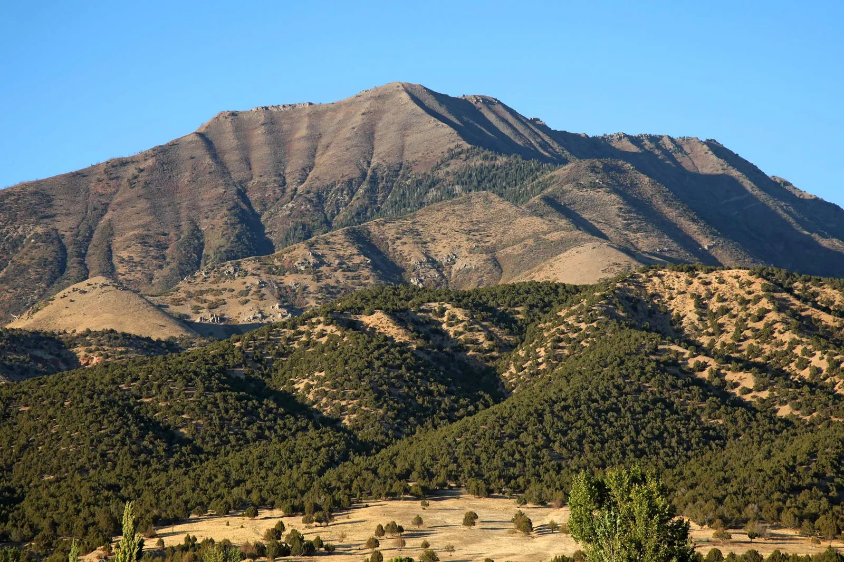
CMPT 306
Areas of Interest
Mount Zirkel Wilderness
40.729 °N 106.776° W to 40.637 °N 106.655 °W
Routt National Forest
Mount Harvard
38.931 °N, 106.384 °W to 38.840 °N, 106.267 °W
Sawatch Range
Wasatch Mountain Range
40.469 °N 111.472 °W to 40.379 ° N 111.353 °W
Deer Creek Reservoir
Links to Downloads
Zirkel
Harvard
Wasatch
Notes:
https://www.sciencebase.gov/catalog/item/63daa312d34e9fa19a97d9a4 zirkel
https://www.sciencebase.gov/catalog/item/60c98620d34e86b9389f3613 harvard
https://www.sciencebase.gov/catalog/item/693258b7d4be0240826e9096 wasatch

Slide 5
CMPT 306
Libraries
Rasterio is a Python library used to access geospatial raster data.
PIL stands for Python Imaging Library used for image manipulation.
Libraries used in useMountain.py and drawPath.py.
rasterio
numpy
heapq
matplotlib
PIL
Notes:
Rasterio leverages NumPy's powerful array objects to efficiently handle and manipulate raster data.

Slide 6
CMPT 306
Algorithms
Similar set up to eight puzzle and AStar maze
Successors are the pixels up to the right, down to the right, and straight forward
Manhattan distance calculation
Heuristic value calculated by absolute value of elevation difference times column difference
Dictionary for tracking visiting
End goal is at the lowest point at the rightmost column
Goal test is true is it reaches the rightmost column

Slide 7

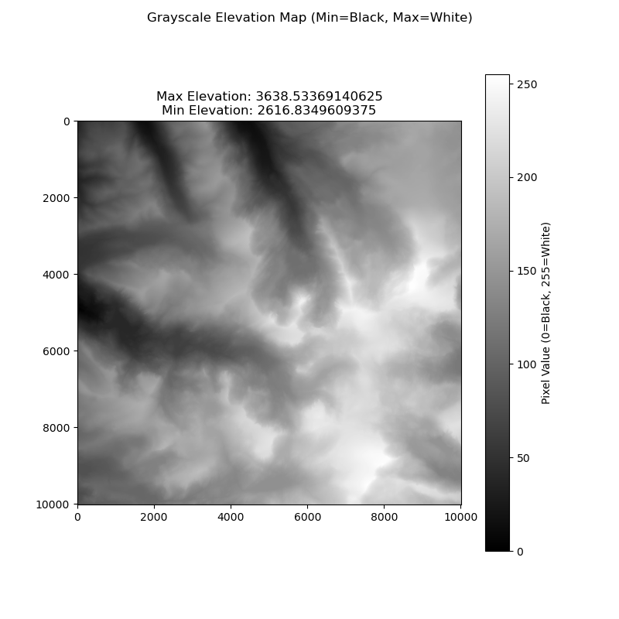
CMPT 306
Zirkel

Slide 8
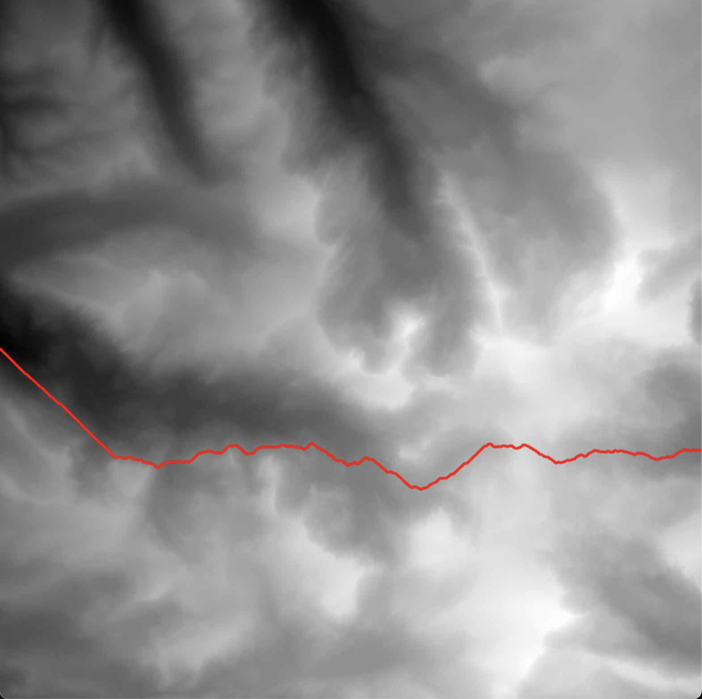
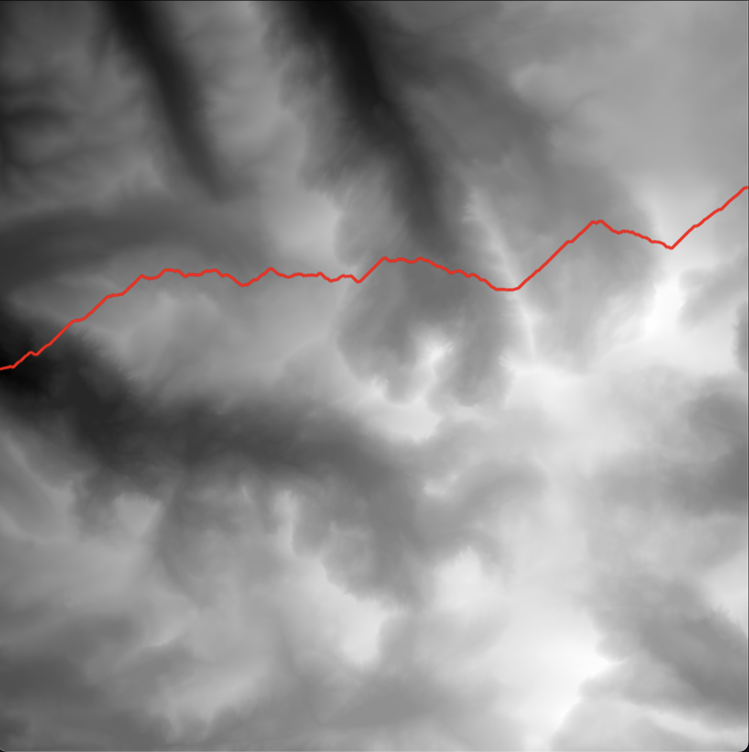
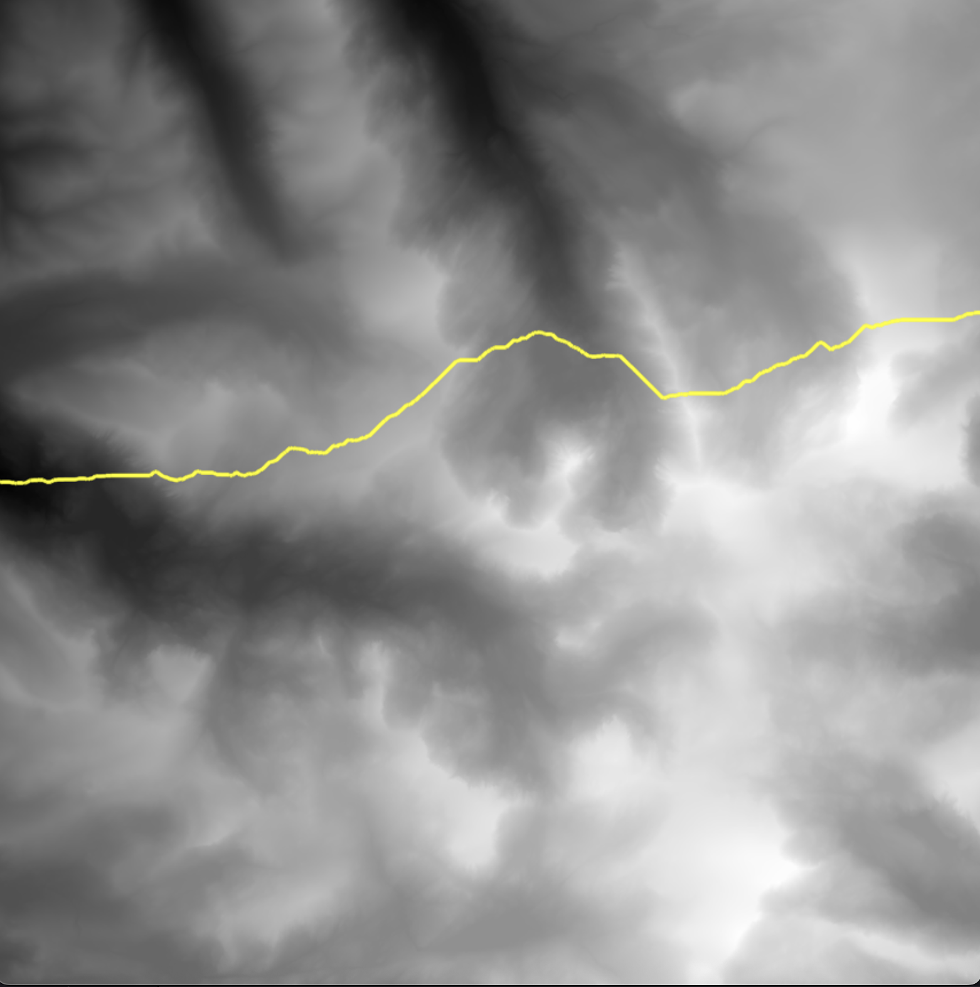
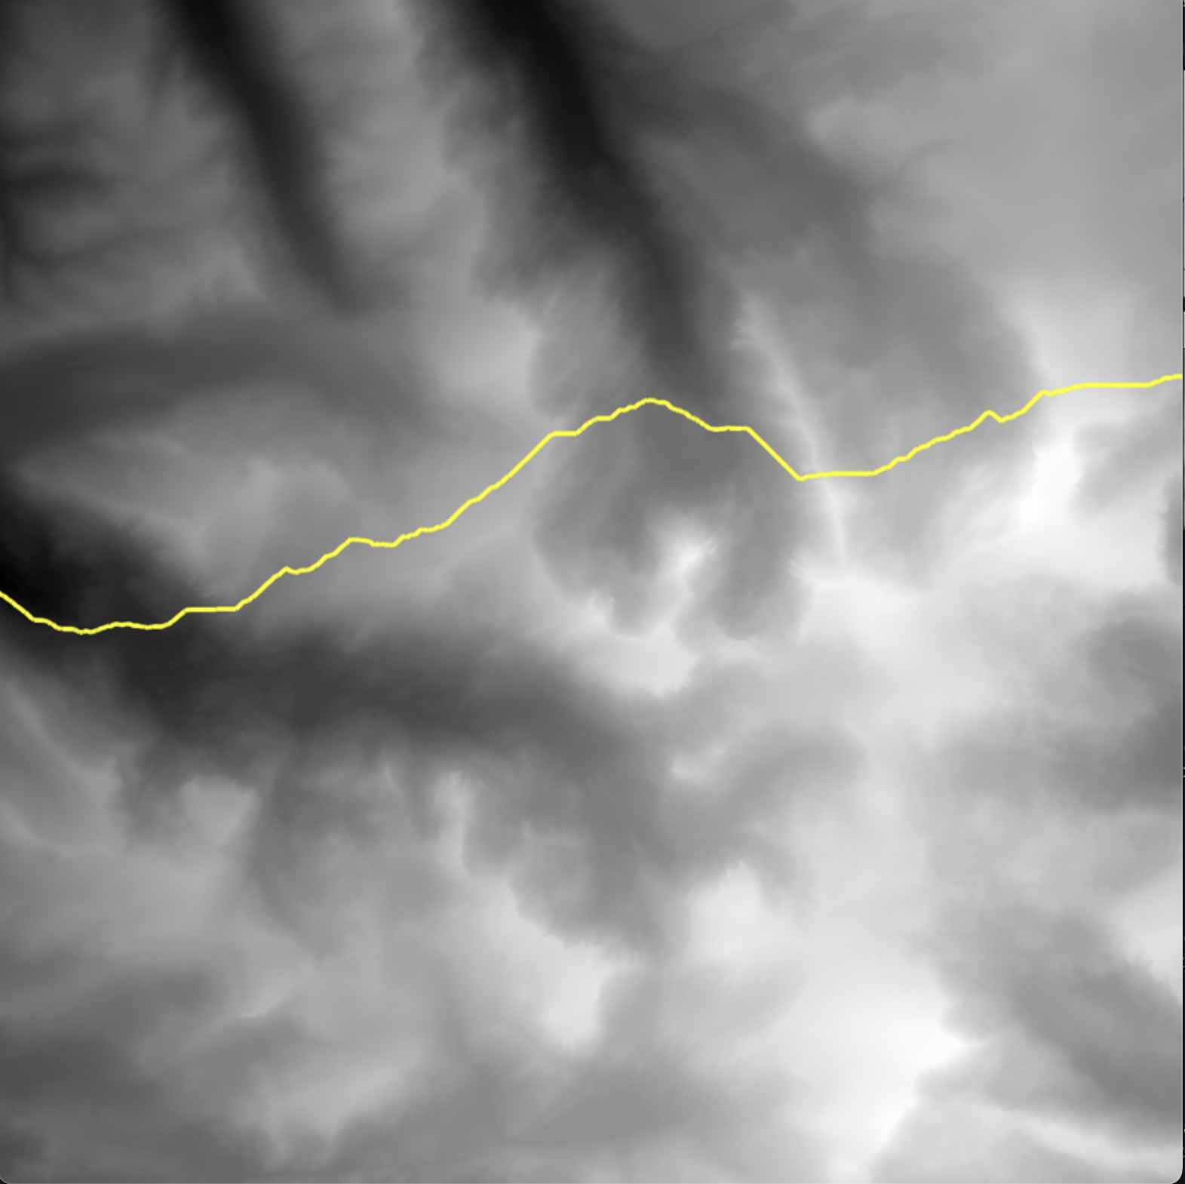
CMPT 306
Zirkel
Greedy with lowest starting point
Greedy with middle starting point
AStar with middle starting point
AStar with lowest starting point

Slide 9

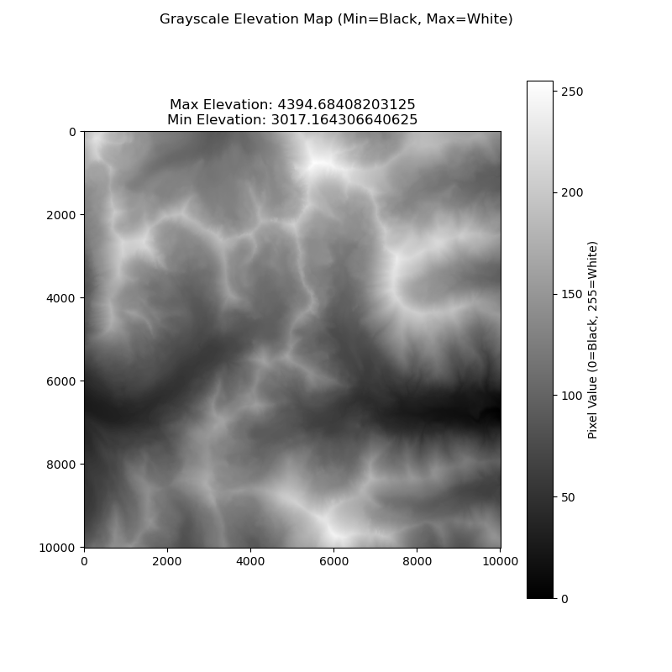
CMPT 306
Harvard

Slide 10
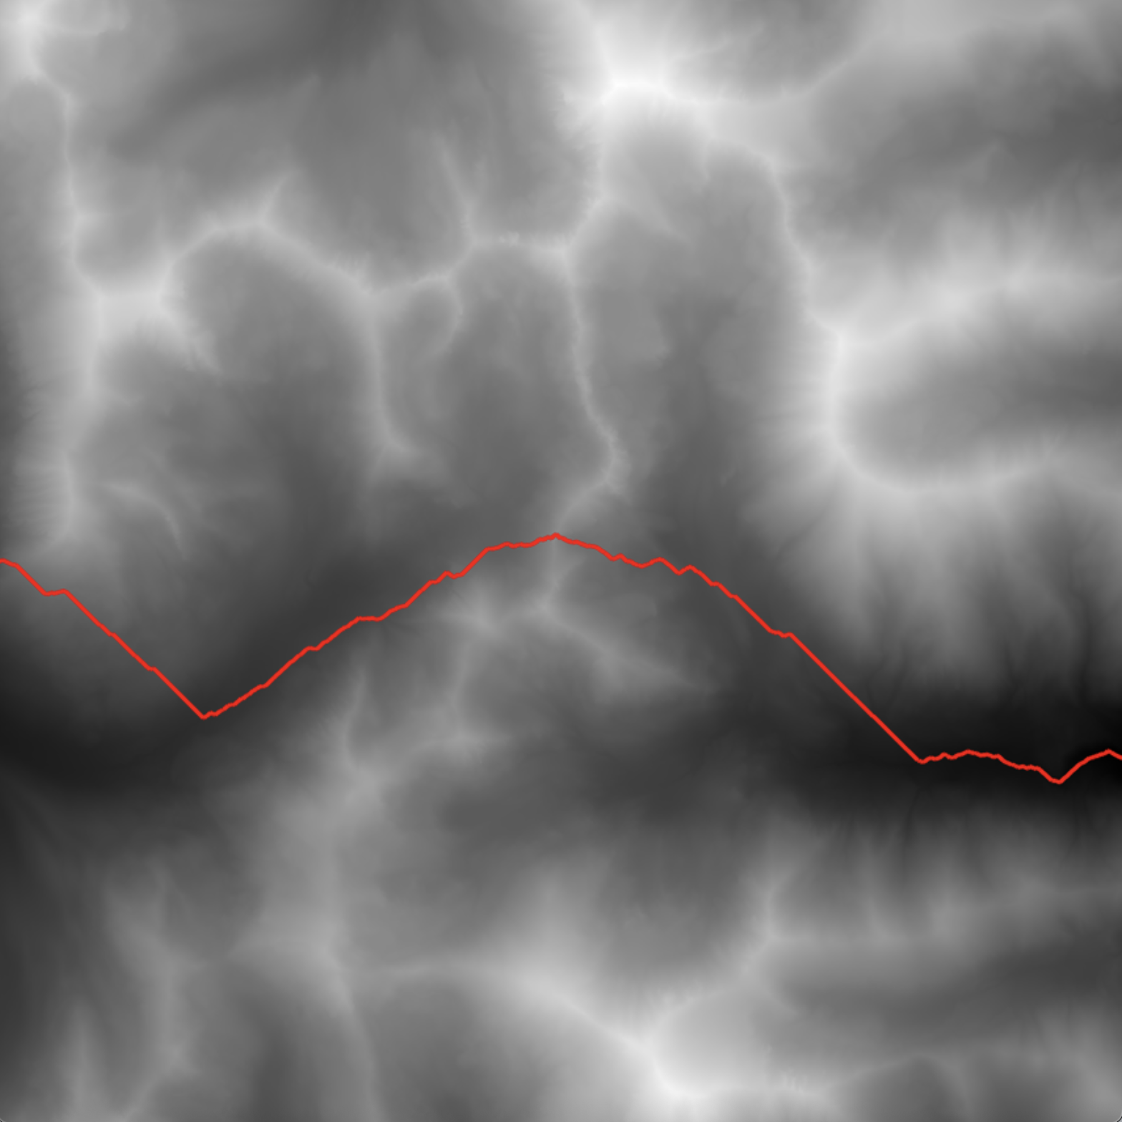
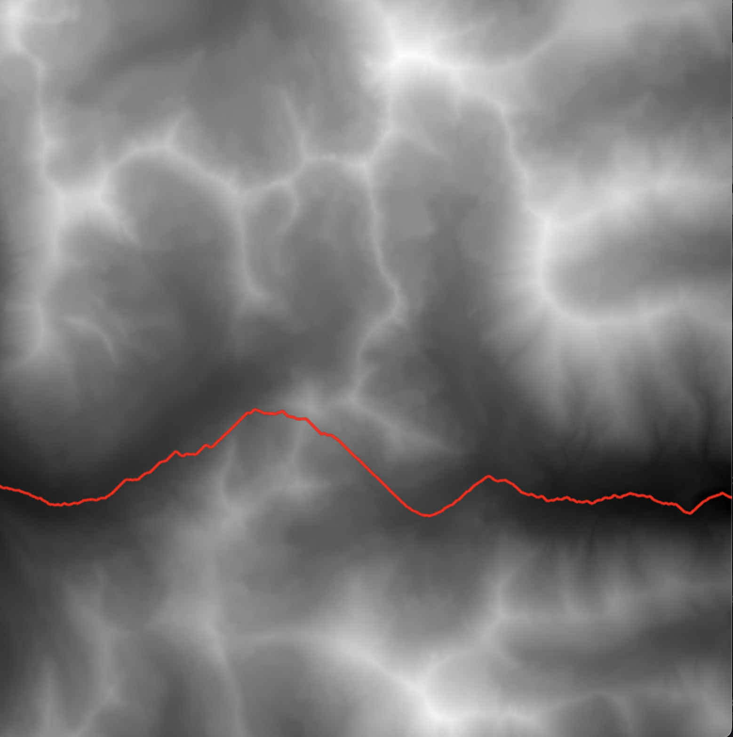
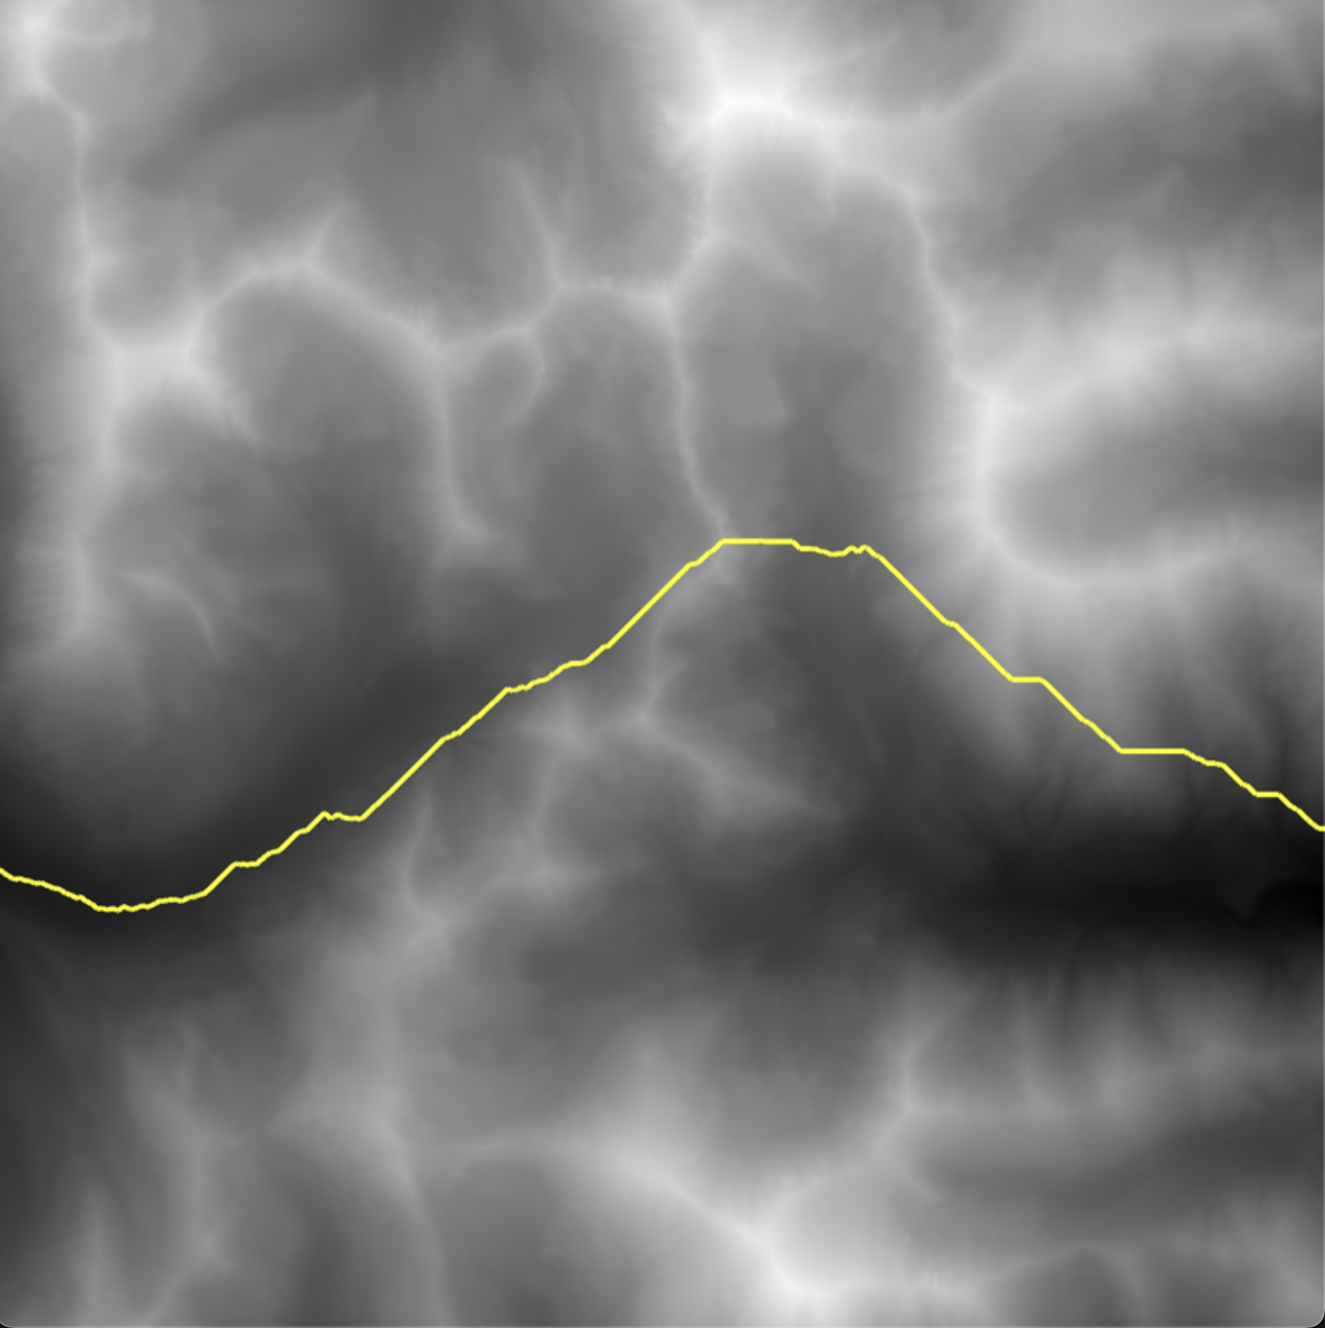
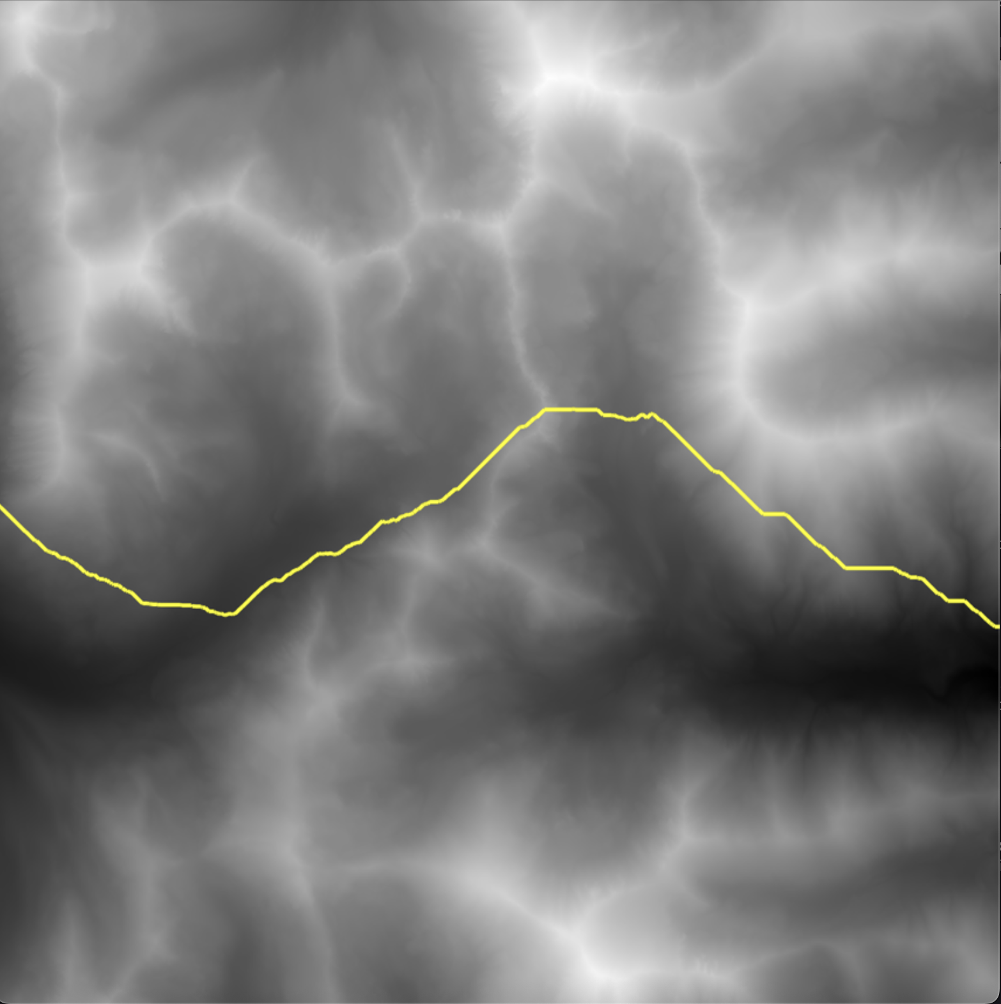
CMPT 306
Harvard
Greedy with lowest starting point
Greedy with middle starting point
AStar with middle starting point
AStar with lowest starting point

Slide 11
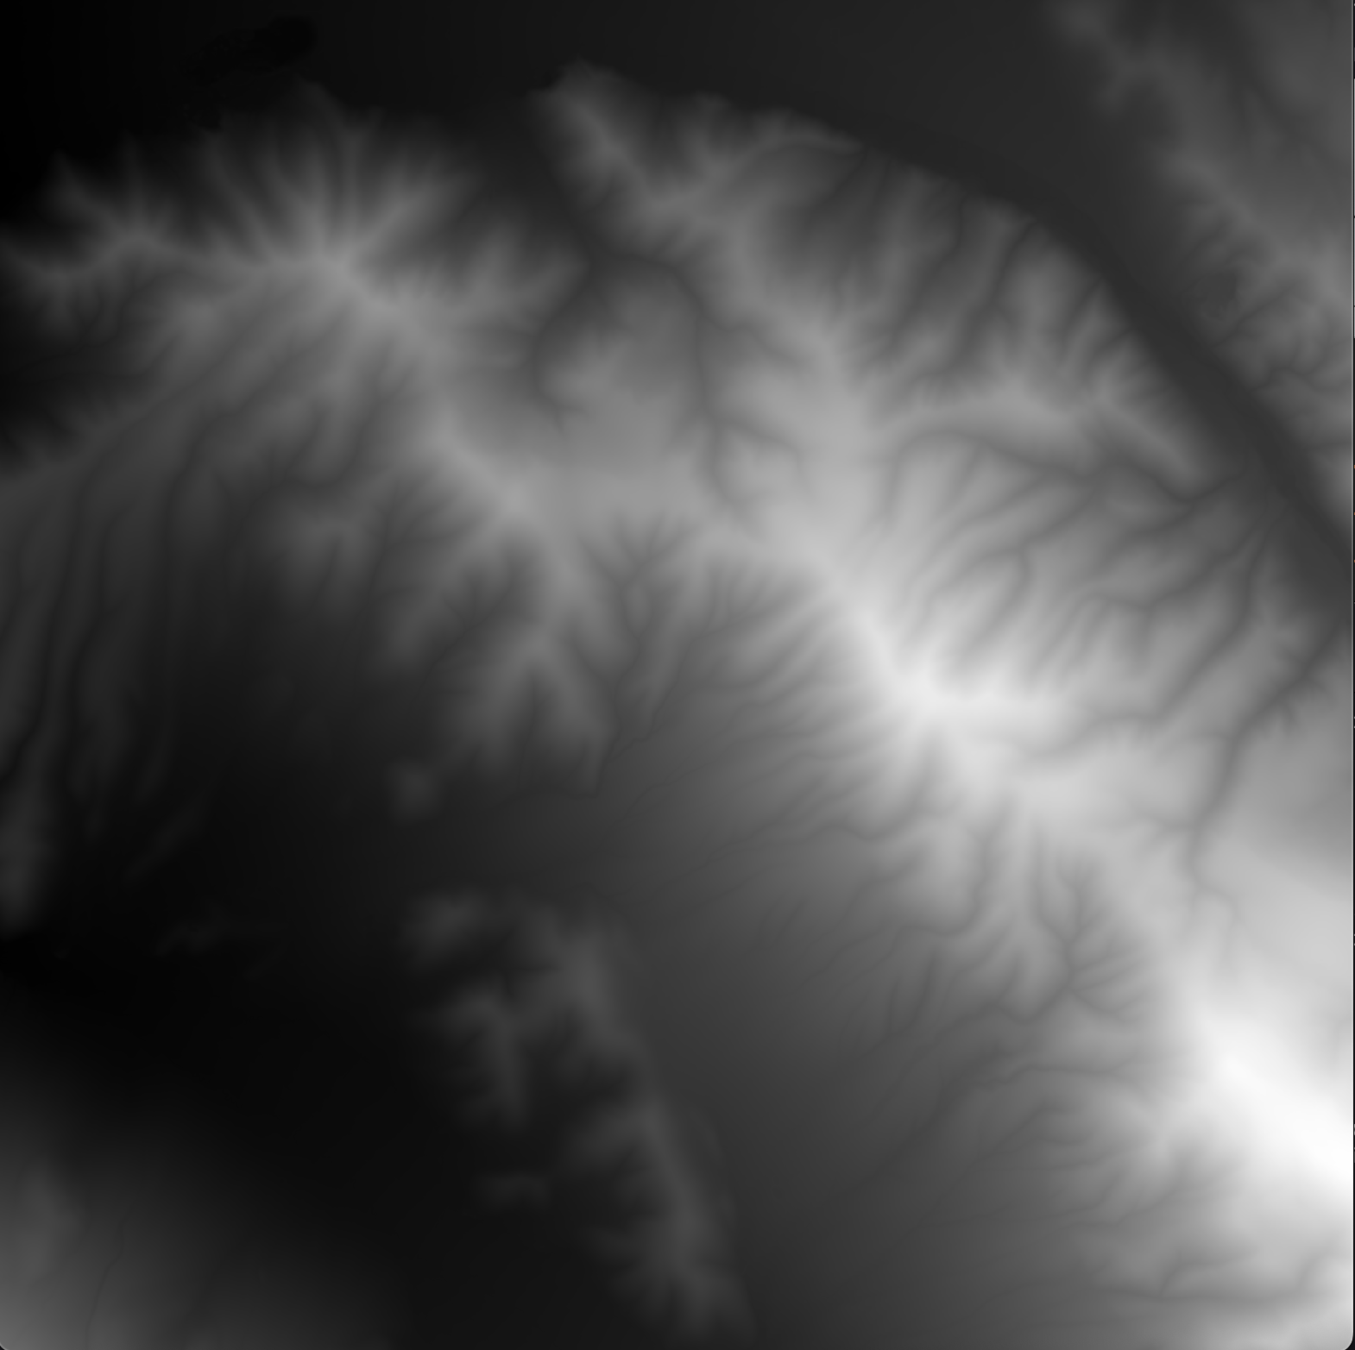
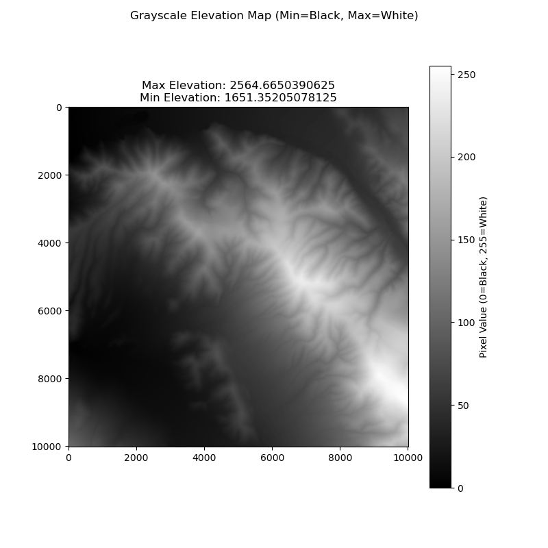
CMPT 306
Wasatch

Slide 12
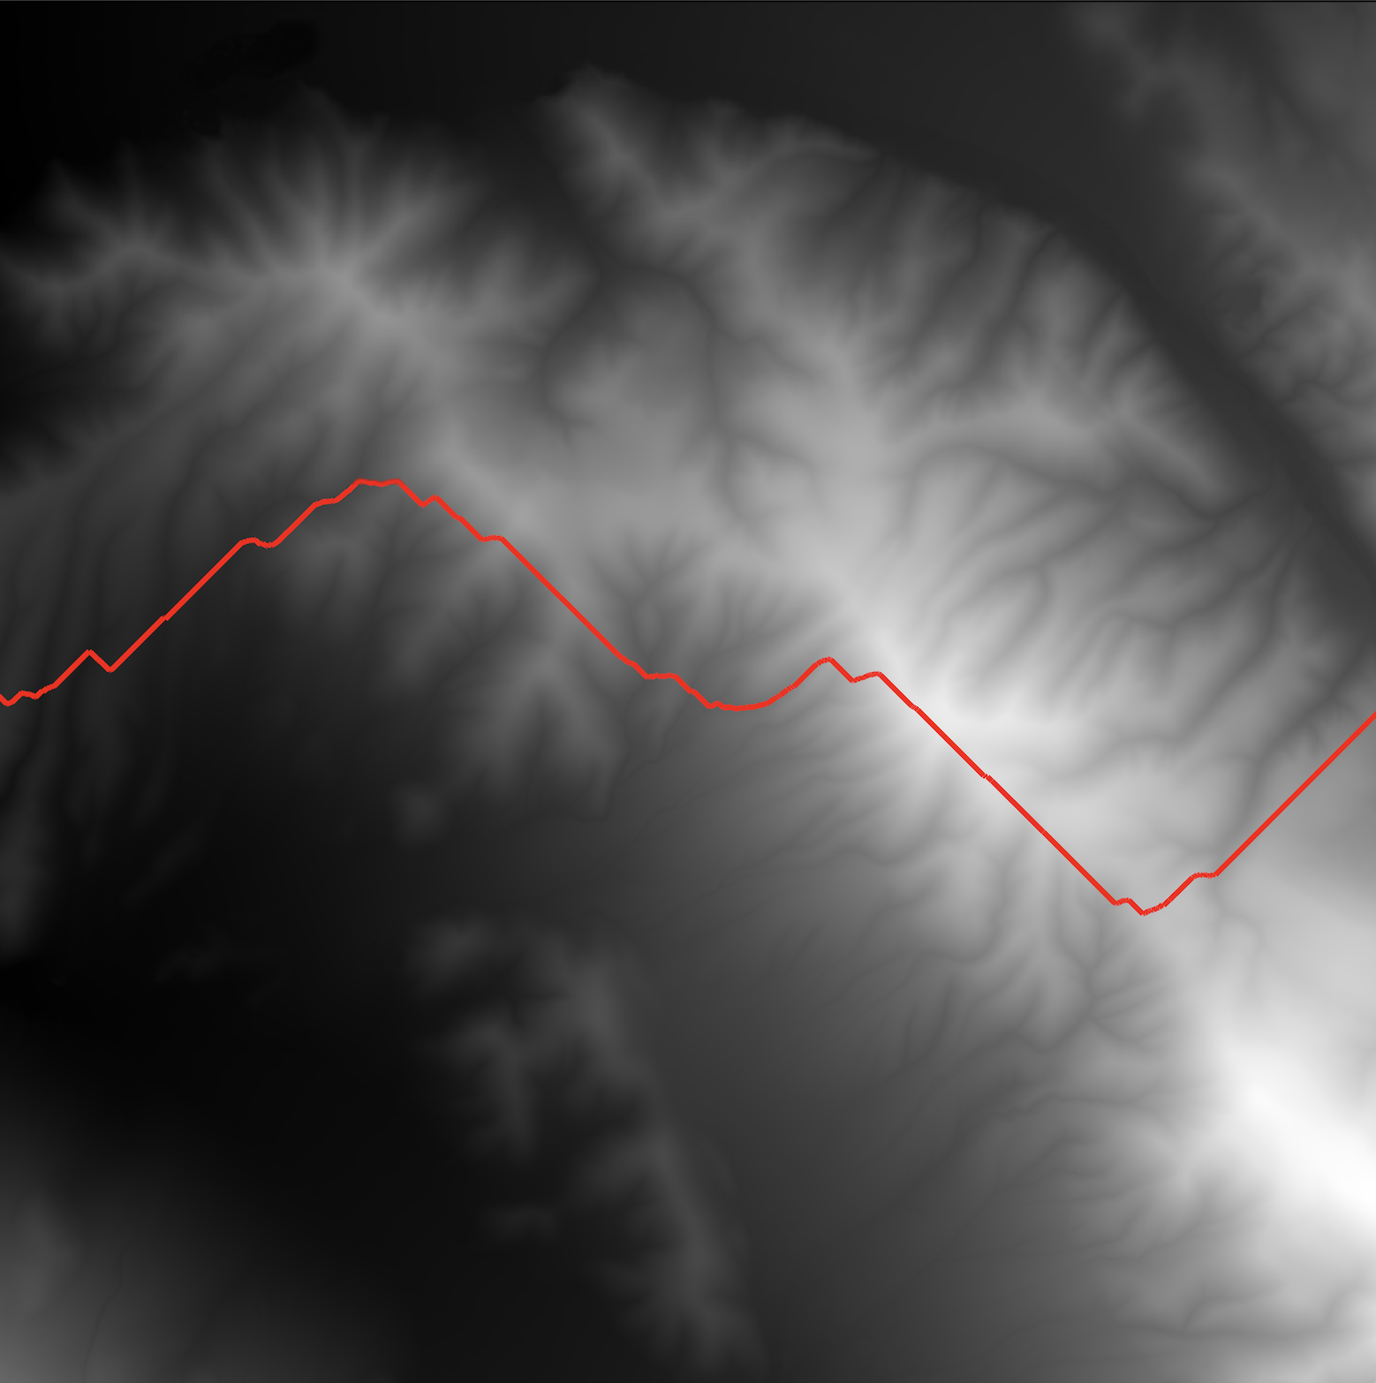
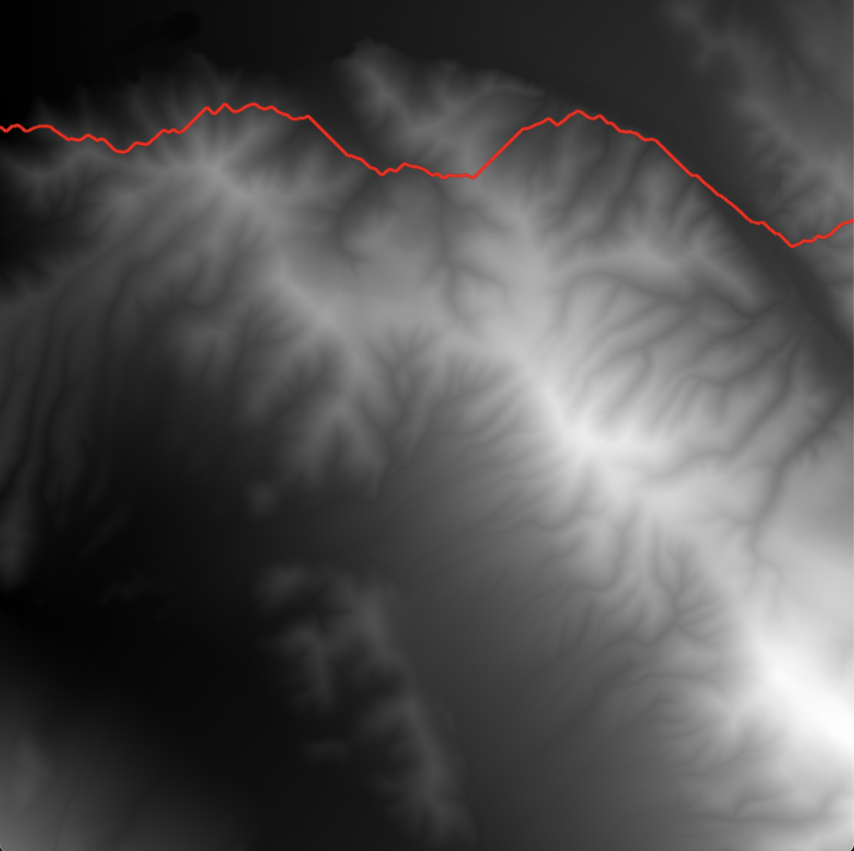
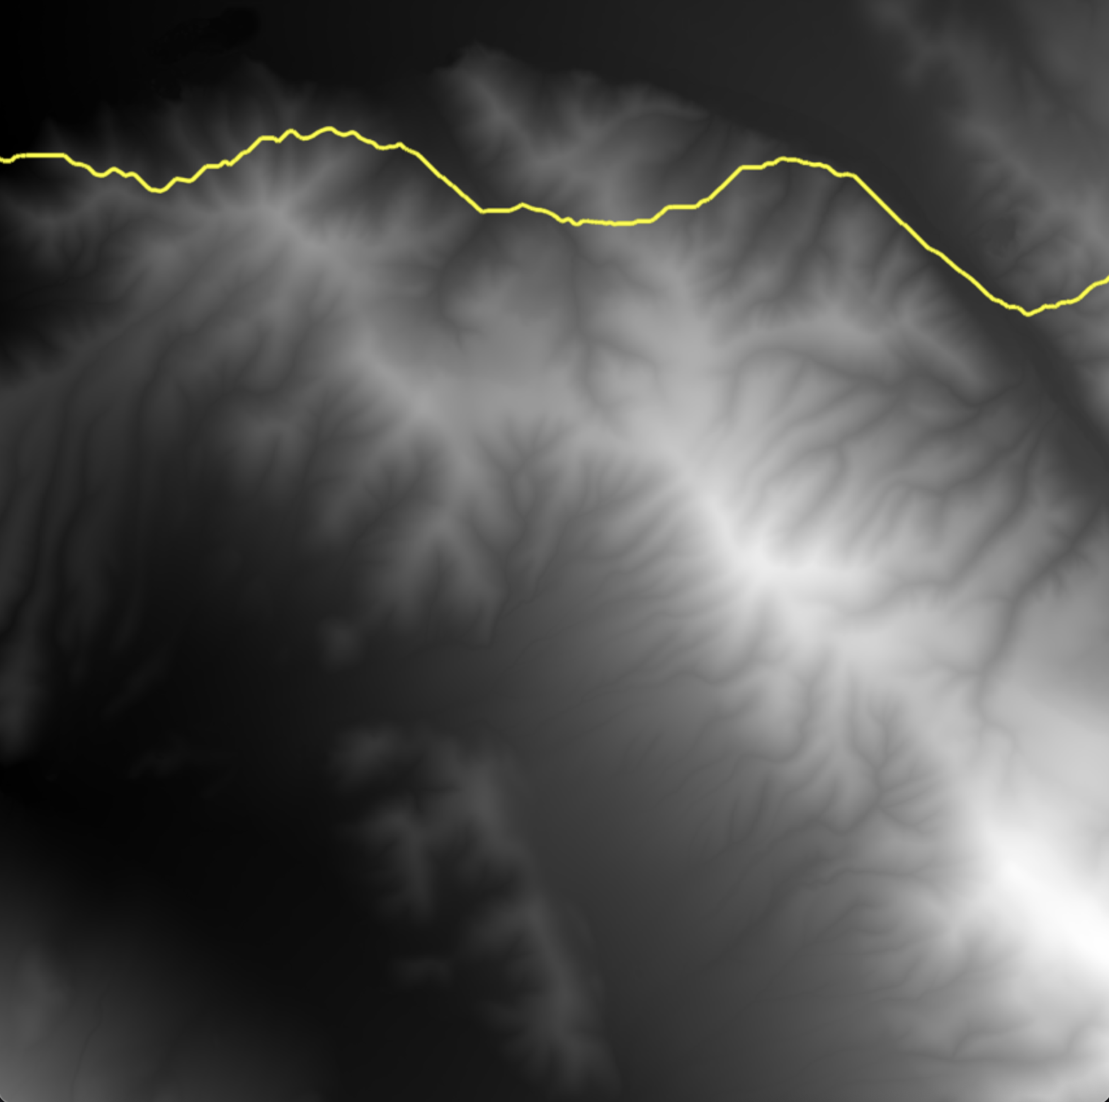
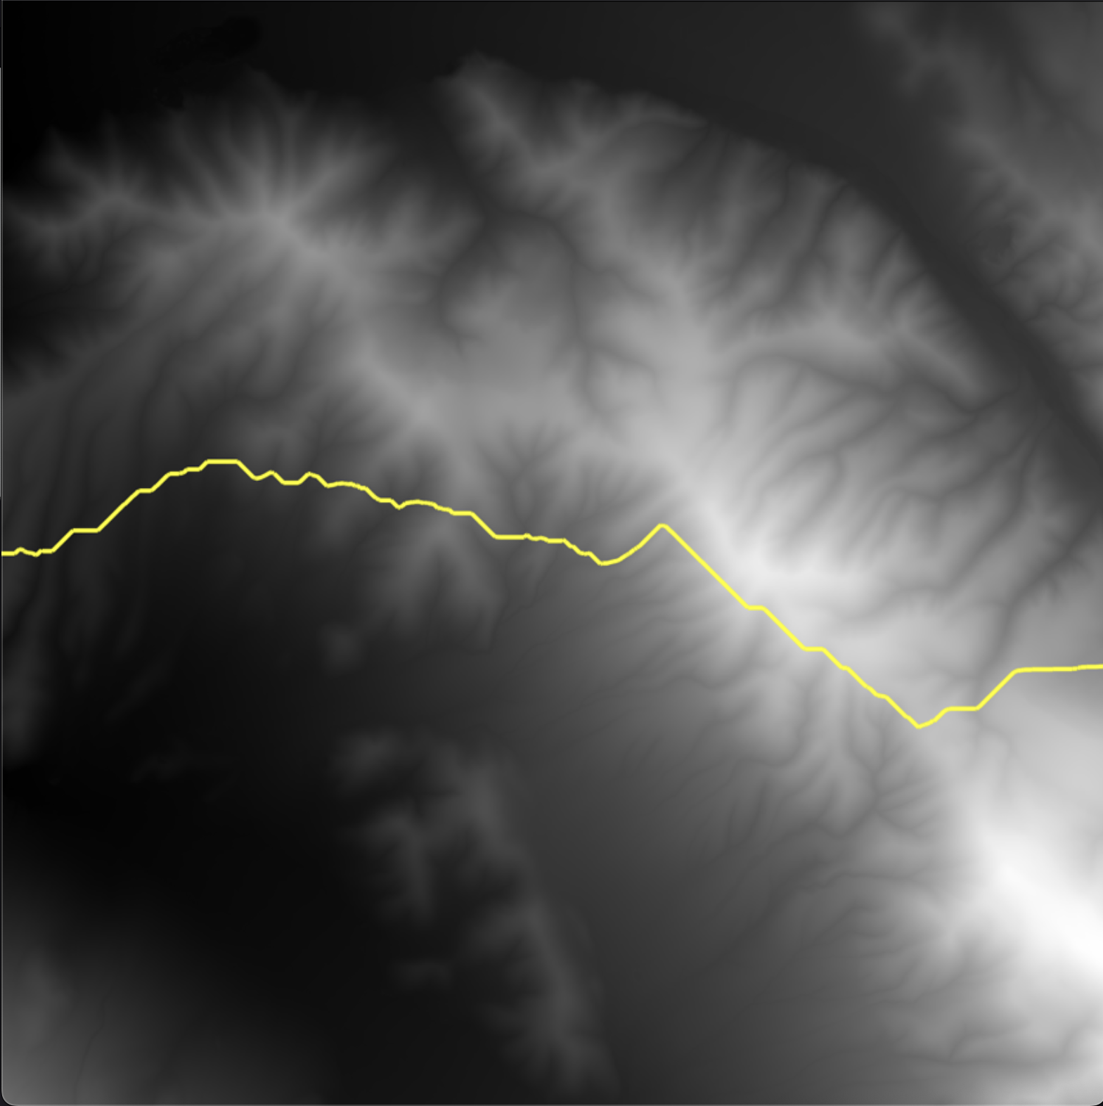
CMPT 306
Wasatch
Greedy with lowest starting point
Greedy with middle starting point
AStar with middle starting point
AStar with lowest starting point

Slide 13
CMPT 306
Questions

